Slide 1


Machine Learning and Network-Based Bioinformatics Models to Identify the Genetic Effect of SARS-COV-2 Infections to Idiopathic Pulmonary Fibrosis(IPF) Patients
Department of Information Technology
University of Information Technology & Sciences (UITS)
Holding 190, Road 5, Block J, Baridhara, Maddha, Naya Nagar Rd, Dhaka 1212

Slide 2

Introduce Ourselves
Presented By
Supervised By
Sk. Tanzir Mehedi
Lecturer
Department of IT, UITS
Imran Hossain (1734255010)
Musfikur Rahaman (16155035)
Tareq Mahmud Tonmoy (1734255015)
Rakibul Alam Limon (1734255012)

Slide 3
Introduction
Objectives
Related Works
Methodology
Data Analysis
Results Analysis
Identification of DEGs and Common Gene Between Covid-19 & IPF
Gene Ontology Analysis
Pathways Finding
PPI Network Analysis
Hub Genes Analysis
TF-Gene Interactions
TF-miRNA Coregulatory Network
Candidate Drug Identification
Conclusion
Reference
Outlines

Slide 4
Introduction

Slide 5
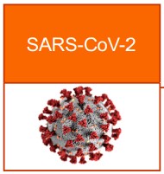
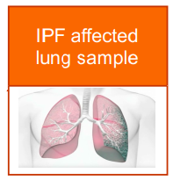
Introduction
The ongoing coronavirus (COVID-19) pandemic has driven universal health and healthcare exigency, aside from the remarkable socio-economic effects.
Virus genome sequencing is a vital and rapidly-developing tool in the diagnosis of COVID-19 and in understanding the spread and control of the new coronavirus.
Idiopathic pulmonary fibrosis (IPF) is a risk factor for COVID-19 as patients with long-term lung injuries are more likely to suffer in the brutishness of the pestilence.

Slide 6
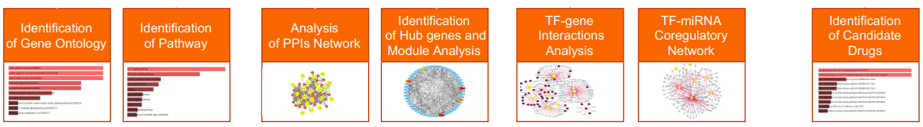
Introduction
Machine learning helps positively by discovering an effective identification for Severe Acute Respiratory Syndrome Coronavirus 2 (SARS-CoV-2) with IPF.

Slide 7
Objectives

Slide 8
Objectives
We will use machine learning methods which will provide a strong identification genetic effect of SARS-CoV-2 infections with IPF diseases.
Also, try to find out the discrete effects of SARS-CoV-2 infections with IPF diseases by network based analysis.
Find Effect of SARS-CoV-2 virus for IPF patients.
Find the biological pathways and the other relationship between COVID-19 and IPF patients.
Finding common genes and possible targets drug.
To present more accurate results by comparing network based analysis with others.

Slide 9
Related Works

Slide 10
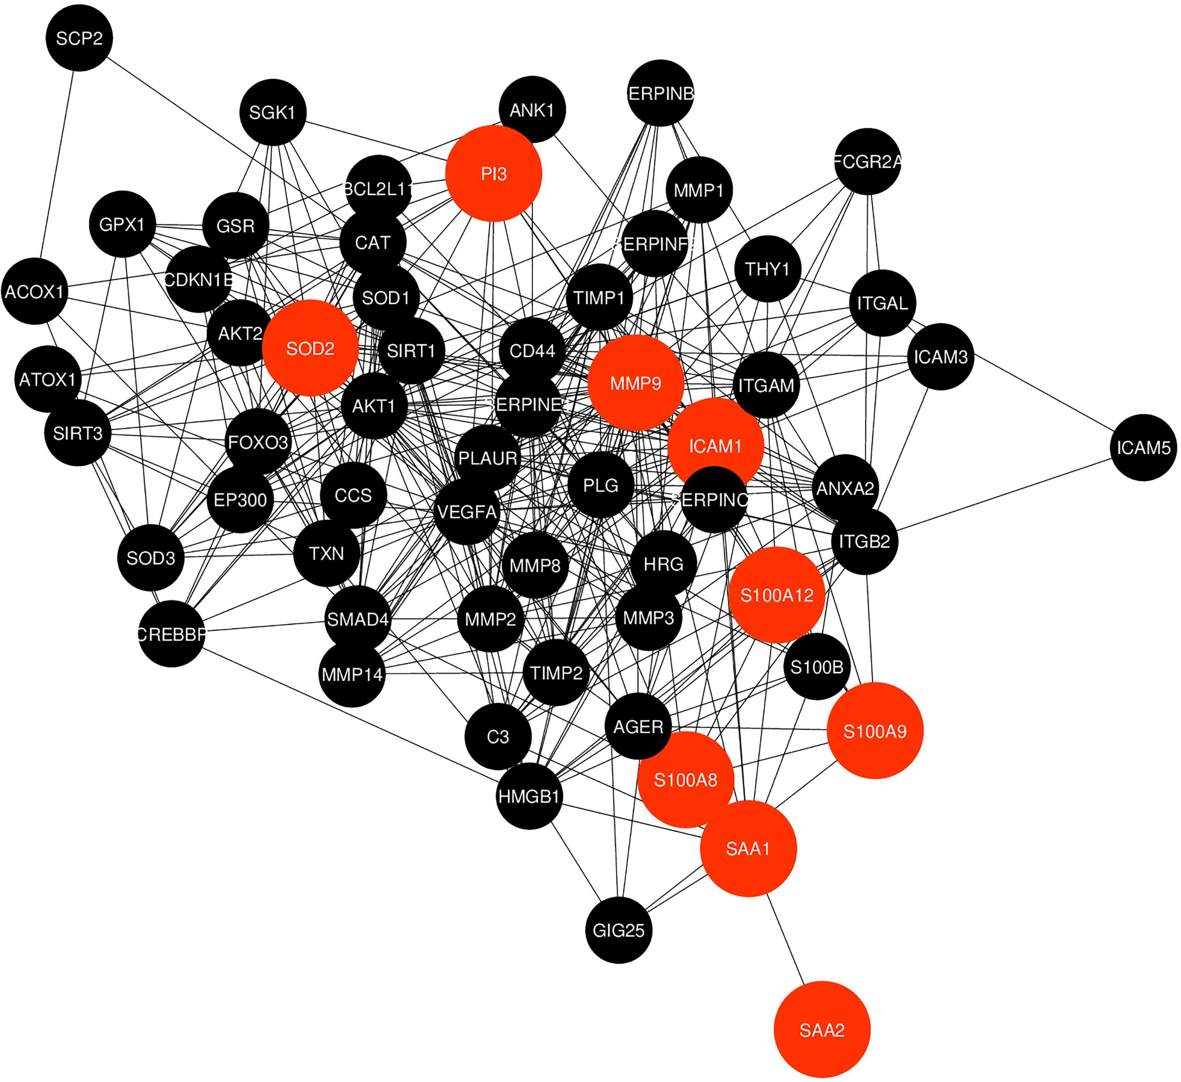
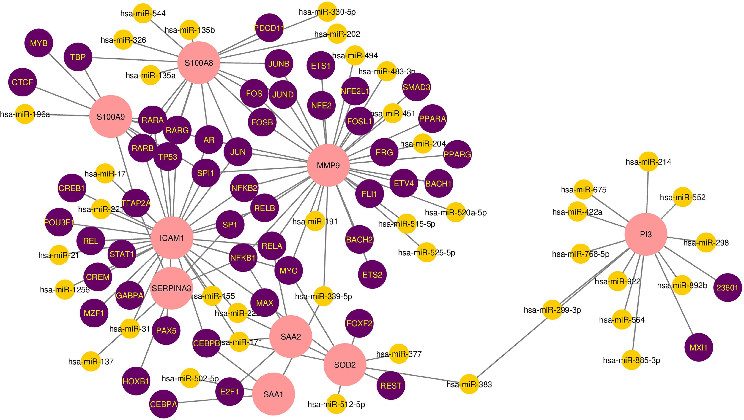
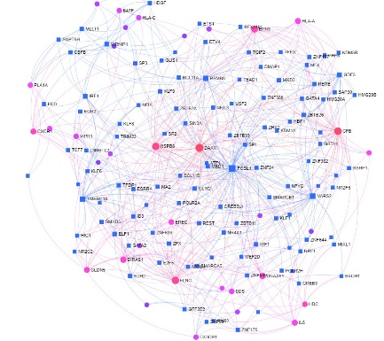
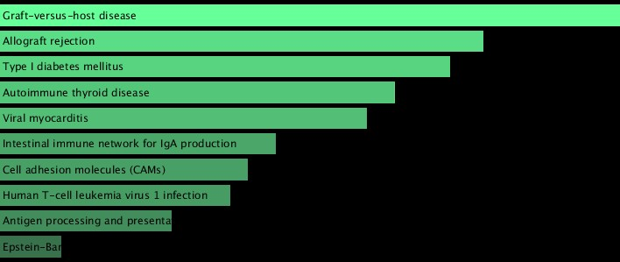
Related Works
Network Based Identification
System Biology Approach Based
Accomplished analysis between two database
Eleven Common Gene between Covid-19 and IFP
Find gene ontology and pathway by enrichment analysis
Identification performance is good
Three dataset was used COVID-19, IFP & COPD
Total 65 Common Gene are identified
Find pathway and others analysis by enrichment analysis
Drug-target interactions are suggested from Hub genes

Slide 11
Methodology

Slide 12
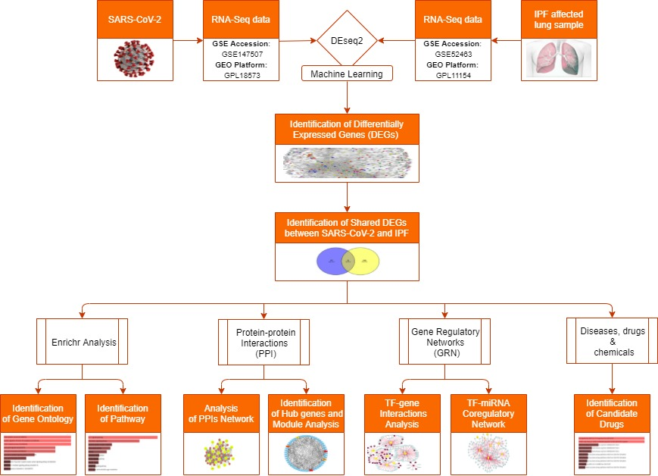
Methodology

Slide 13
Data Analysis

Slide 14
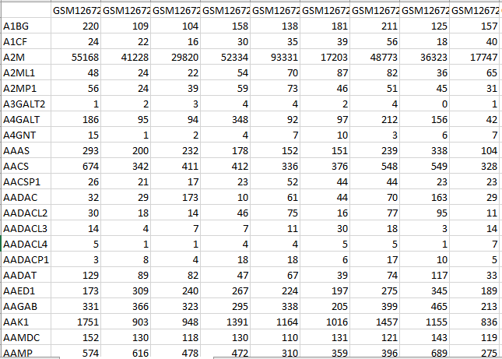
Data Analysis
GEO Database
GSE 147507
MetaData (Filtered)
CountData (Normalized)
GSE 52463
MetaData (Filtered)
CountData (Normalized)

Slide 15
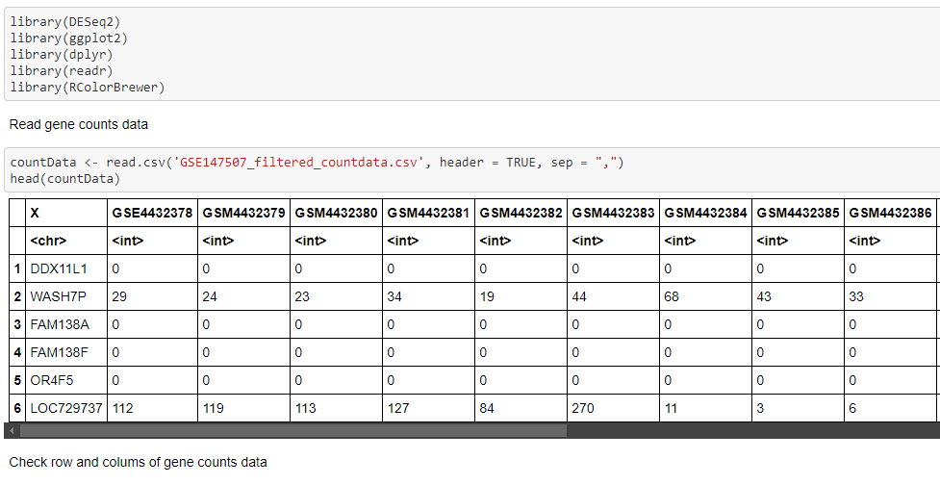
Data Analysis
Analysis with Machine Learning
Cut-Off :
P-Value < 0.05
| log2FC | > 1.0

Slide 16
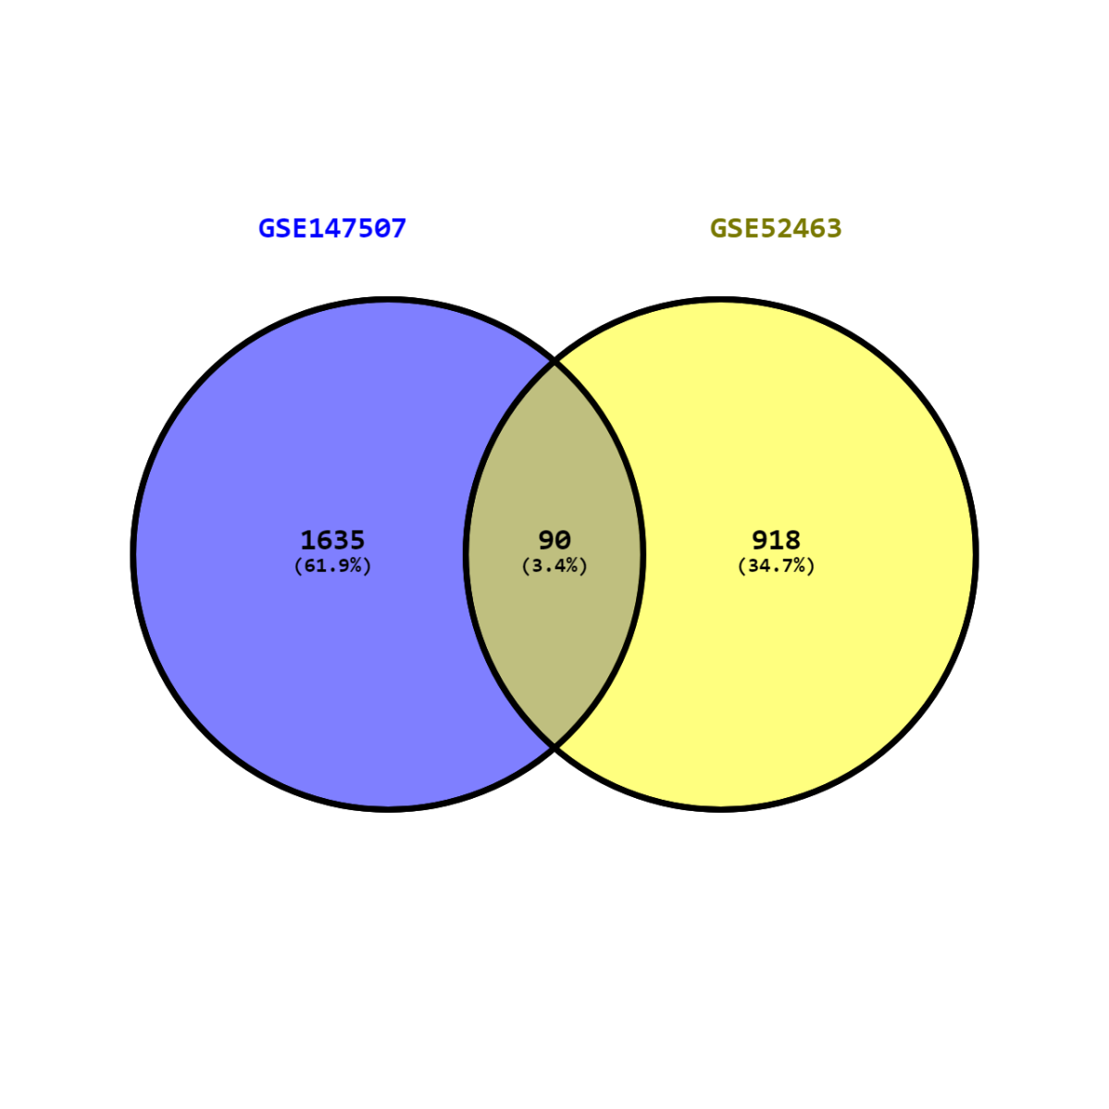
Data Analysis
GSE-147507
Total - 1725
Up Regulated – 926
Down Regulated – 799
GSE-52463
Total - 1008
Up Regulated – 669
Down Regulated - 339
Common Gene: 90

Slide 17
Result Analysis

Slide 18
Gene Pathways Finding
Pathways
KEGG
Wiki Pathways
Reactome
BioCarta

Slide 19
Gene Pathways Finding
Pathway analysis refers to a method of initial characterization and interpretation of pathological condition that was studied with omics tools.
This studies might identify long lists of altered genes.
Interaction among molecules in a cell that leads to a certain change in a cell.
This methods of pathway analysis might be used to identify key genes/ proteins .

Slide 20
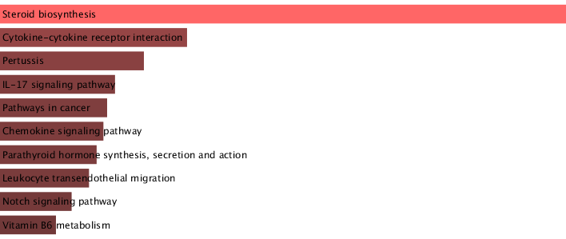
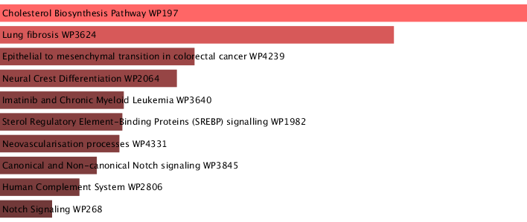
Pathways Finding
Pathways (Top 10 Pathways for each of the subsections)
Database | Pathways | P-Value | Gene
KEGG | Steroid biosynthesis | 1.41E-06 | CYP24A1;CYP51A1;MSMO1;LSS
 | Cytokine-cytokine receptor interaction | 2.13E-03 | ACVRL1;CXCL6;IL1RN;CCL11;TNFSF8;CCL18
 | Pertussis | 4.89E-03 | CXCL6;SFTPA2;SFTPA1
 | IL-17 signaling pathway | 0.008541751 | CXCL6;CCL11;MMP1
 | Pathways in cancer | 0.009944168 | DLL4;MMP1;EPAS1;GADD45A;NOTCH4;STAT4;PIM2
 | Chemokine signaling pathway | 0.010692617 | CXCL6;CCL11;ARRB1;CCL18
 | Parathyroid hormone synthesis, secretion and action | 0.01217993 | CYP24A1;PDE4B;ARRB1
 | Leukocyte transendothelial migration | 0.014115739 | CLDN5;RHOH;CLDN2
 | Notch signaling pathway | 0.019753727 | DLL4;NOTCH4
 | Vitamin B6 metabolism | 0.026701191 | PSAT1
WikiPathways | Cholesterol Biosynthesis Pathway WP197 | 5.04E-07 | FDPS;CYP51A1;MSMO1;LSS
 | Lung fibrosis WP3624 | 9.44E-06 | CCL11;SFTPA2;SFTPC;SFTPA1;SMAD7
 | Epithelial to mesenchymal transition in colorectal cancer WP4239 | 7.61E-04 | DLL4;CLDN5;CDH2;NOTCH4;CLDN2
 | Neural Crest Differentiation WP2064 | 0.001122419 | DLL4;TFAP2A;CDH2;NOTCH4
 | Imatinib and Chronic Myeloid Leukemia WP3640 | 0.003609434 | GADD45A;PIM2
 | Sterol Regulatory Element-Binding Proteins (SREBP) signalling WP1982 | 0.003725975 | FDPS;CYP51A1;LSS
 | Neovascularisation processes WP4331 | 0.003977743 | ACVRL1;DLL4
 | Canonical and Non-canonical Notch signaling WP3845 | 0.006533184 | DLL4;NOTCH4
 | Human Complement System WP2806 | 0.009581233 | SFTPA2;SFTPA1;CFB
 | Notch Signaling WP268 | 0.017488237 | DLL4;NOTCH4

Slide 21
Gene Ontology Finding
Gene Ontology
GO Biological Process
GO Molecular Function
GO Cellular Component

Slide 22
Gene Ontology Finding
The Gene Ontology is a major bioinformatics initiative to unify the representation of gene and gene product attributes across all species.
The gene ontology allows users to describe a gene to gene products in detail

Slide 23
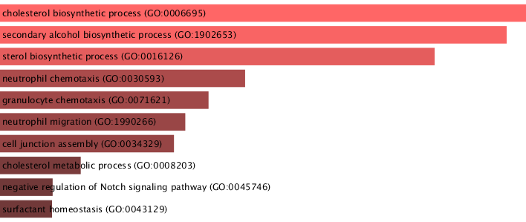
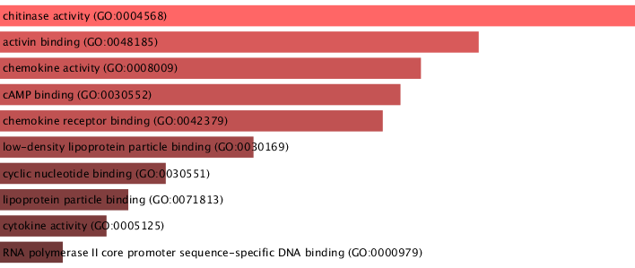
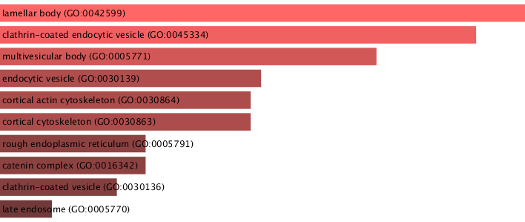
Gene Ontology Finding
Gene Ontology (Top 10 GO terms for each of the subsections)
Category | GO ID | GO pathways | P-value | Genes
GO biological process | GO:0006695 | Cholesterol biosynthetic process | 1.80E-05 | FDPS;CYP51A1;MSMO1;LSS
 | GO:1902653 | Secondary alcohol biosynthetic process | 2.02E-05 | FDPS;CYP51A1;MSMO1;LSS
 | GO:0016126 | Sterol biosynthetic process | 3.10E-05 | FDPS;CYP51A1;MSMO1;LSS
 | GO:0030593 | Neutrophil chemotaxis | 9.49E-05 | CXCL6;CCL11;PDE4B;CCL18
 | GO:0071621 | Granulocyte chemotaxis | 1.18E-04 | CXCL6;CCL11;PDE4B;CCL18
 | GO:1990266 | Neutrophil migration | 1.35E-04 | CXCL6;CCL11;PDE4B;CCL18
 | GO:0034329 | Cell junction assembly | 1.44E-04 | CLDN5;CDH2;FLNC;SMAD7
 | GO:0008203 | Cholesterol metabolic process | 2.51E-04 | FDPS;CYP51A1;MSMO1;LSS
 | GO:0045746 | Negative regulation of Notch signaling pathway | 2.96E-04 | DLL4;EGFL7;ARRB1
 | GO:0043129 | Surfactant homeostasis | 2.97E-04 | SFTPA2;SFTPA1
GO Molecular Function | GO:0004568 | Chitinase activity | 4.14E-04 | CHIT1;CHI3L2
 | GO:0048185 | Activin binding | 8.80E-04 | ACVRL1;SMAD7
 | GO:0008009 | Chemokine activity | 0.001162919 | CXCL6;CCL11;CCL18
 | GO:0030552 | cAMP binding | 0.001283478 | POPDC3;PDE4B
 | GO:0042379 | Chemokine receptor binding | 0.001397778 | CXCL6;CCL11;CCL18
 | GO:0030169 | Low-density lipoprotein particle binding | 0.00260634 | TNFAIP6;PCSK9
 | GO:0030551 | Cyclic nucleotide binding | 0.003977743 | POPDC3;PDE4B
 | GO:0071813 | Lipoprotein particle binding | 0.004764343 | TNFAIP6;PCSK9
 | GO:0005125 | Cytokine activity | 0.005292261 | CXCL6;IL1RN;CCL11;CCL18
 | GO:0000979 | RNA polymerase II core promoter sequence-specific DNA binding | 0.006533184 | TFAP2A;POU2AF1
GO Cellular Component | GO:0042599 | Lamellar body | 3.86E-05 | SFTPA2;SFTPC;SFTPA1
 | GO:0045334 | Clathrin-coated endocytic vesicle | 7.54E-05 | SFTPA2;SFTPC;CD207;SFTPA1
 | GO:0005771 | Multivesicular body | 0.000295817 | SFTPA2;SFTPC;SFTPA1
 | GO:0030139 | Endocytic vesicle | 0.001438507 | SFTPA2;SFTPC;CD207;SFTPA1
 | GO:0030864 | Cortical actin cytoskeleton | 0.001660448 | CLDN5;CDH2;MYZAP
 | GO:0030863 | Cortical cytoskeleton | 0.001660448 | CLDN5;CDH2;MYZAP
 | GO:0005791 | Rough endoplasmic reticulum | 0.007015271 | SFTPA2;SFTPA1
 | GO:0016342 | Catenin complex | 0.007015271 | CDH2;SMAD7
 | GO:0030136 | Clathrin-coated vesicle | 0.010407203 | SFTPA2;SFTPC;SFTPA1
 | GO:0005770 | Late endosome | 0.025350026 | SFTPA2;PCSK9;SFTPA1

Slide 24
PPIs Network Analysis
A protein-protein interaction (PPI) network represents a platform by which we have this chance to systematically identify disease-related genes from the relations between genes with similar functions.

Slide 25
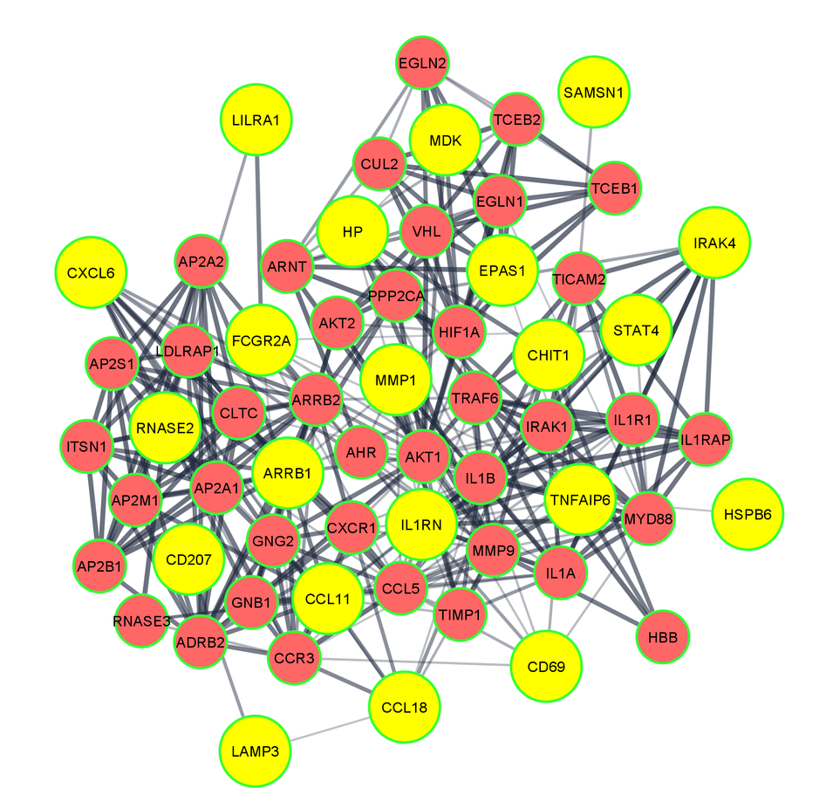
PPI Network
Node- 60
Edge- 308

Slide 26
Identification of Hub Genes
The Nodes that have most interactions in PPI considered Hub Gene.
Hub genes are defined as genes with high correlation in candidate modules. High connectivity means that the connectivity ranked at top 10%.

Slide 27
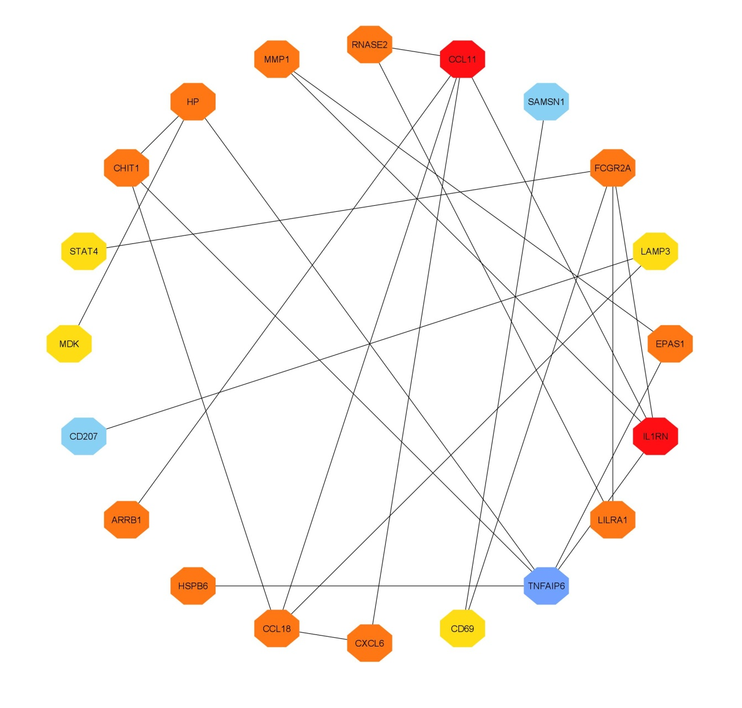
Hub Genes
Top-18
Nodes-20
Edges-24
Effectful gene: 13

Slide 28
TF-Gene Interactions
TF gene interaction with the identified common DEGs evaluates the outcome of TF on functional pathways and expression levels of the genes.

Slide 29
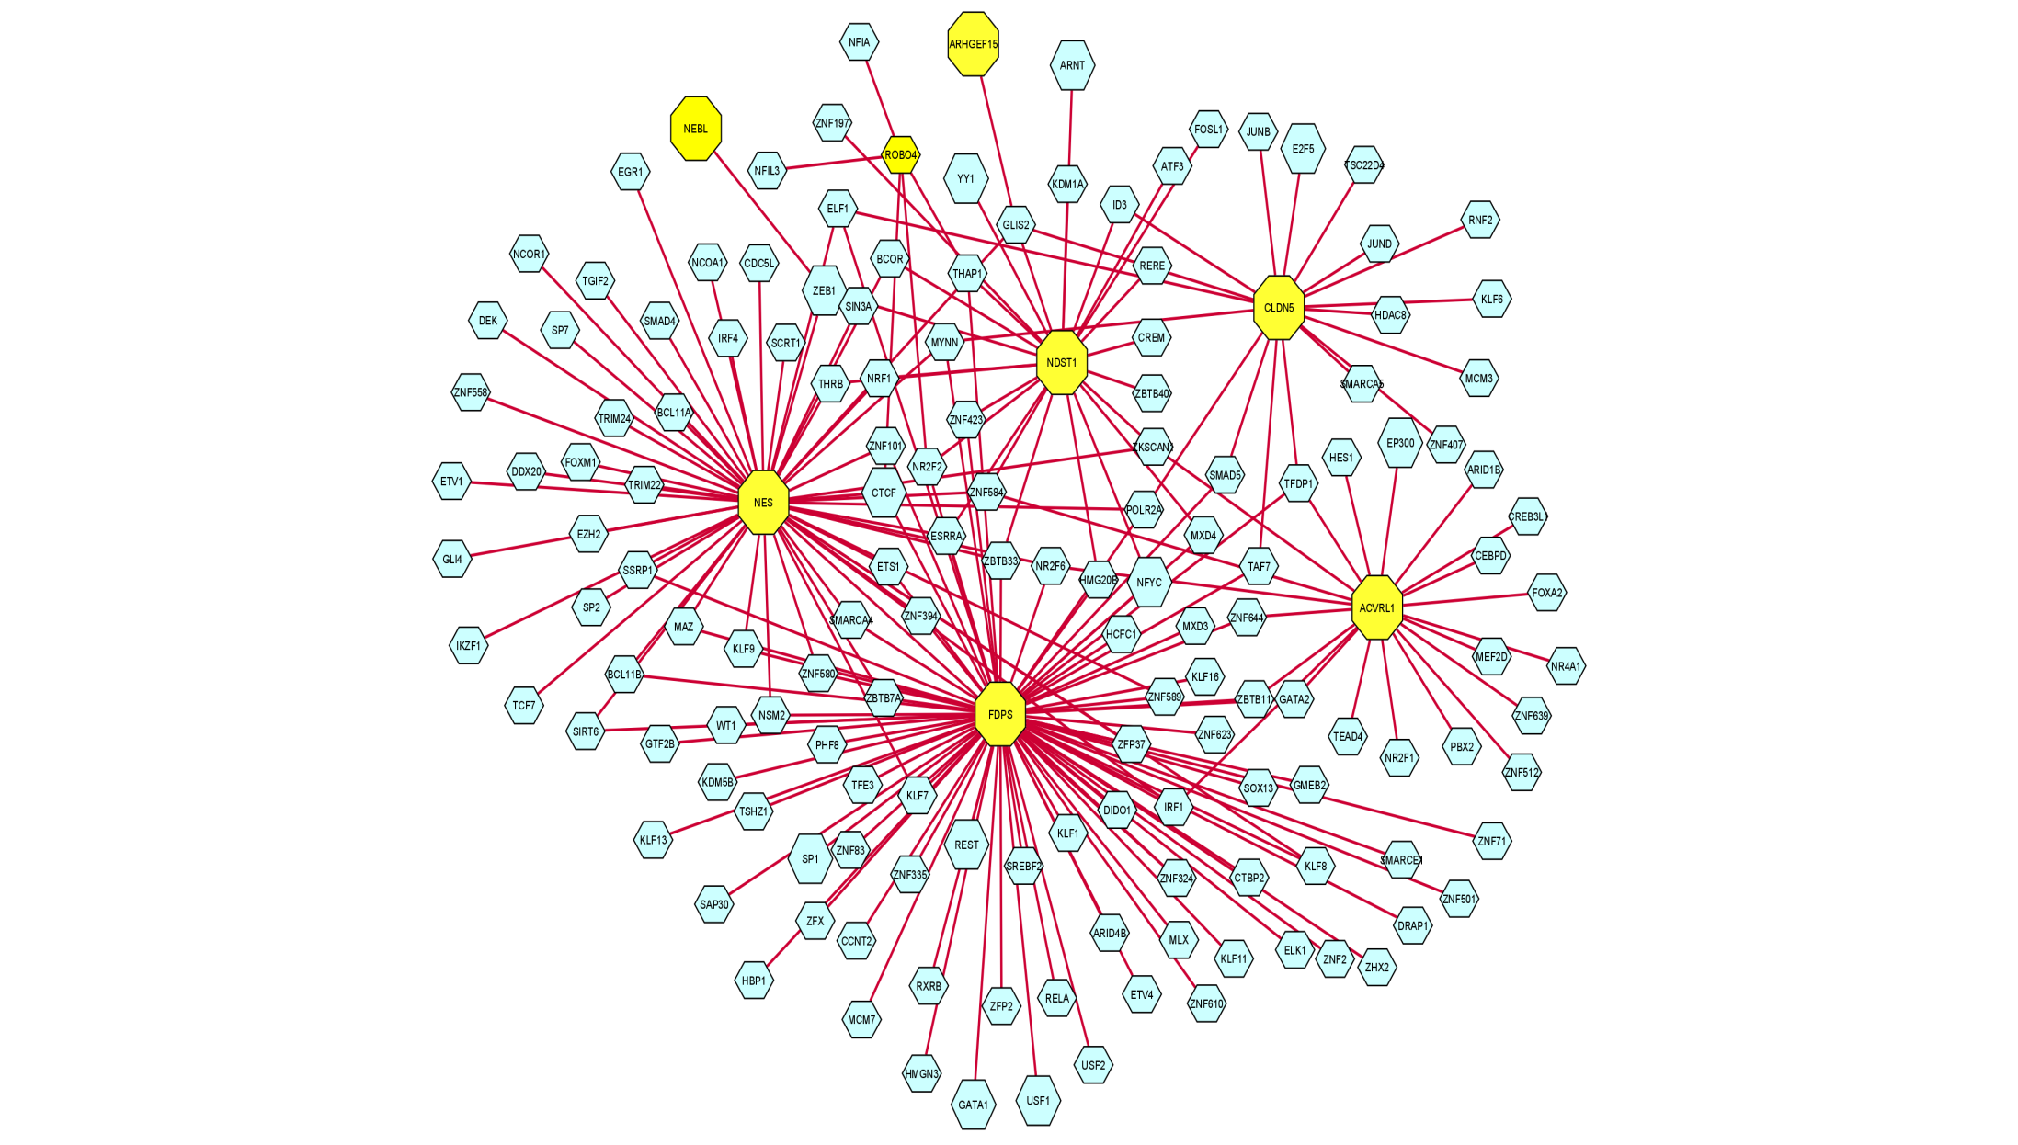
TF-Gene Interactions
Node- 155
Edge- 208
TF-Gene- 147
DEGs Gene -8

Slide 30
TF-miRNA Coregulatory Network
The analysis of the TF-miRNA coregulatory network delivers miRNAs and TFs interaction with the common DEGs.

Slide 31
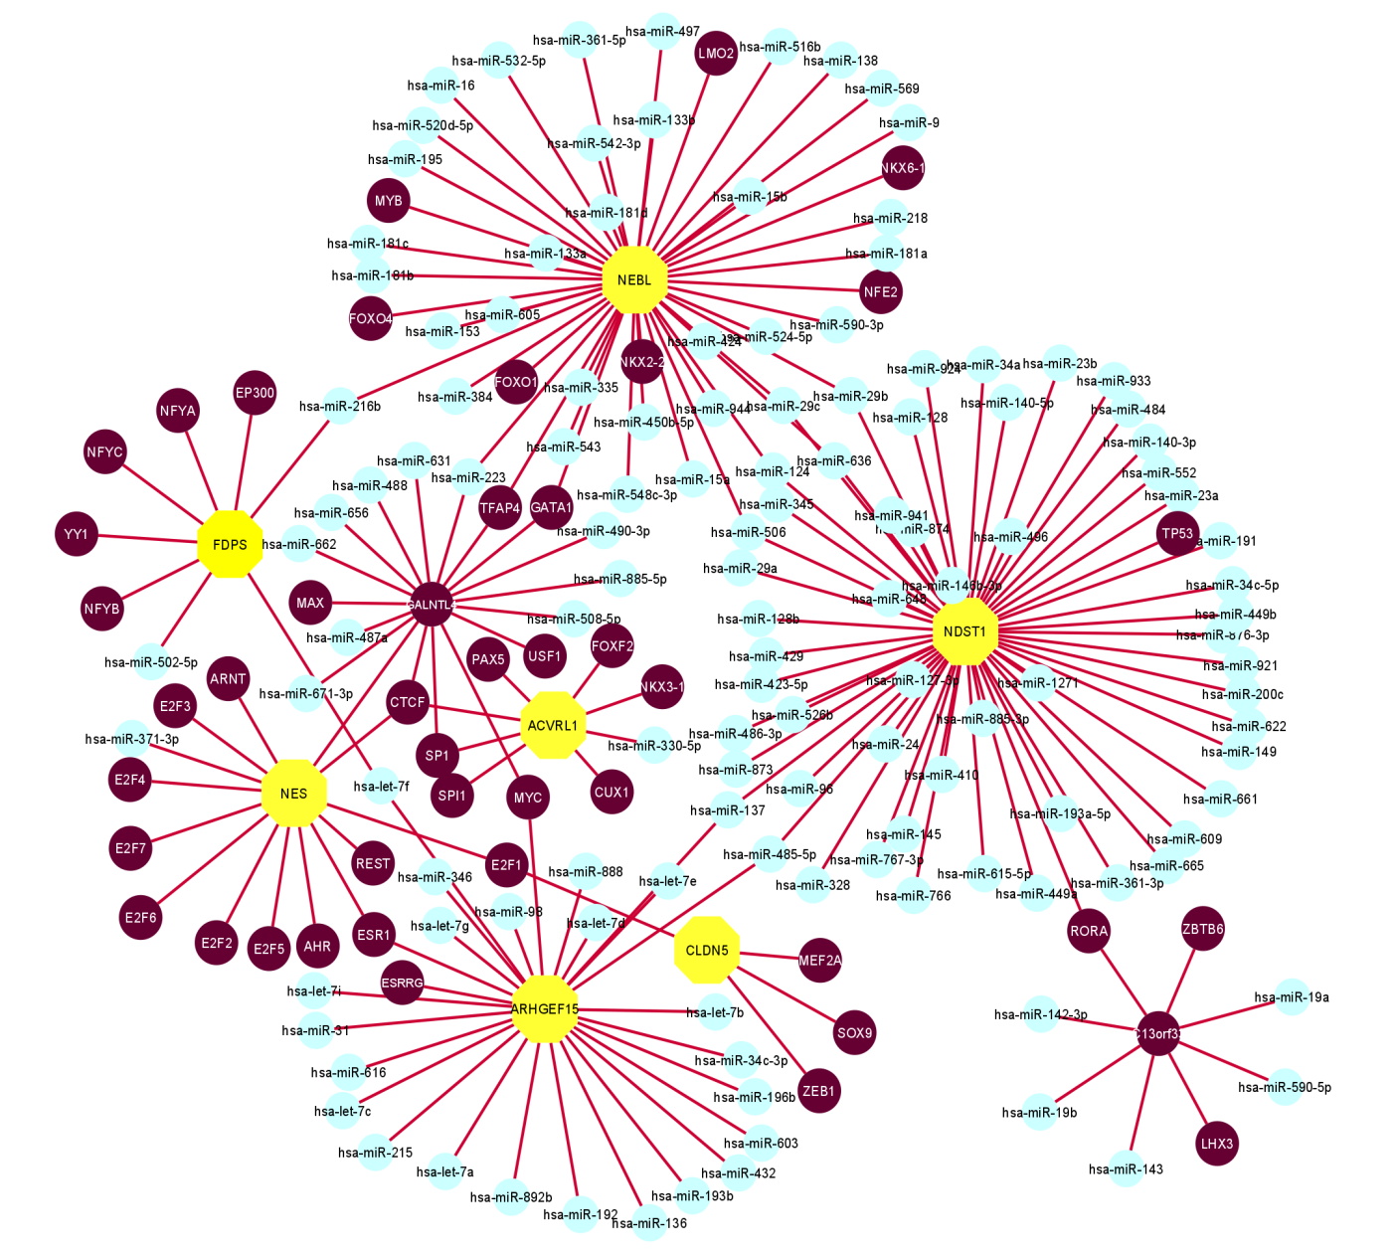
TF-miRNA Coregulatory Network
Node- 179
Edge- 189
miRNA- 125
DEGs – 7
TF Gene - 47

Slide 32
Identification of Candidate Drug
According to P-value and adjusted P-value, the results from the candidate drugs were generated.
The analysis depicts that two drug molecules are mostly interacted with most of the genes.
As these signature drugs were detected for the common DEGs, these drugs represent common drugs for COVID-19 and IPF.

Slide 33
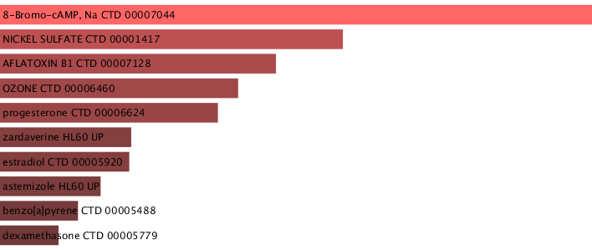
Candidate Drug
Name of drugs | P-value | Adjusted P-value | Genes
8-Bromo-cAMP, Na CTD 00007044 | 1.22358E-06 | 0.001936931 | SFTPA2;TRPA1;GADD45A;SFTPC;CYP51A1;MSMO1;LSS;RASIP1;MEDAG;CAPN6;PSAT1;LAMP3;PAPPA;SLC39A8
NICKEL SULFATE CTD 00001417 | 1.02815E-05 | 0.008137833 | CXCL6;IL1RN;CCL11;TNFAIP6;MMP1;EPAS1;LAMP3;CD207;PDE4B;STAT4;CD69;SAMSN1
AFLATOXIN B1 CTD 00007128 | 1.82186E-05 | 0.00947667 | POPDC3;IL1RN;RTKN2;HP;PCSK9;MSMO1;WFDC2;RGS4;SELENBP1;VSIG1;MDK;LAMP3;SLAMF7;PIM2;FLNC;TNS4;FDPS;TRPA1;GADD45A;LSS;CYP24A1;PSAT1;ID3;MNS1;COL9A2;STEAP1;NES;CFB;FREM2;KANK3
OZONE CTD 00006460 | 2.51744E-05 | 0.00947667 | TFAP2A;SFTPA2;TRPA1;SFTPA1
progesterone CTD 00006624 | 2.99326E-05 | 0.00947667 | FDPS;TNFAIP6;MMP1;NEBL;GADD45A;CYP51A1;HP;MSMO1;LRRC32;LSS;WFDC2;MEDAG;RGS4;CLDN5;CYP24A1;CAPN6;PSAT1;PAPPA;PDE4B;ID3;SLC39A8;NES
zardaverine HL60 UP | 6.27591E-05 | 0.014433048 | IL1RN;TNFAIP6;PDE4B;ID3;SAMSN1
estradiol CTD 00005920 | 6.38227E-05 | 0.014433048 | POPDC3;IL1RN;TNFAIP6;HHLA2;HP;PCSK9;MSMO1;LRRC32;PWP2;WFDC2;RGS4;SELENBP1;NDST1;CAPN6;MDK;LAMP3;PDK4;PDE4B;STAT4;SLC39A8;FLNC;MMP1;NEBL;GADD45A;ELOVL2;CYP51A1;LSS;CLDN5;CYP24A1;PSAT1;PAPPA;ID3;MNS1;STEAP1;CFB;FREM2
astemizole HL60 UP | 8.15096E-05 | 0.016128719 | TNFAIP6;CYP51A1;MSMO1;SLC39A8
benzo[a]pyrene CTD 00005488 | 9.88782E-05 | 0.017391584 | ROBO4;IL1RN;TNFAIP6;EPAS1;GALNT18;RTKN2;HP;PCSK9;ARRB1;MSMO1;MEDAG;SELENBP1;CDH2;MDK;LAMP3;PDK4;PDE4B;PIM2;FLNC;TNS4;CDR1;FDPS;MMP1;GADD45A;CYP51A1;LSS;CLDN5;CYP24A1;PSAT1;PAPPA;POU2AF1;TNIP3;ID3;MNS1;CD69;CFB
dexamethasone CTD 00005779 | 0.000116758 | 0.018482771 | SFTPA2;MMP1;LAMP3;SFTPC;HP;SLC39A8;SFTPA1;CD69;NES
Drug molecules that most genes are interacted with :
CTD 00005920
CTD 00005488

Slide 34
Conclusion

Slide 35
Conclusion
A new dimension of machine learning with bioinformatics in the field of medical technology especially for SARS-Cov2 pandemic.
In the context of transcriptomic analysis, a few research has been done so far on SARS-CoV-2 and IPF.
We have accomplished DEGs analysis between two datasets and filtered the materials through common gene identification and attempted to find infection responses between SARS-CoV-2 and IPF affected lung cells.
Analyses regarding SARS-CoV-2 and IPF to predict the way of detecting infections for various diseases.
Our analysis ensure high identification performances between SARS-CoV-2 and IPF.
As SARS-CoV-2 is a recent discovery, there has been little research on its risk factors and infections.
This research will become more and more important with the availability of exceeding datasets.

Slide 36
References
Coronaviridae Study Group of the International Committee on Taxonomy of Viruses.. The species severe acute respiratory syndrome-related coronavirus: classifying 2019-nCoV and naming it SARS-CoV-2. Nat Microbiol 2020;5(4):536–44 .
Walls AC, Park YJ, Tortorici MA, et al. Structure, function, and antigenicity of the SARS-CoV-2 spike glycoprotein. Cell 2020;181(2):281–92 .
George PM, Wells AU, Jenkins RG. Pulmonary fibrosis and COVID-19: the potential role for antifibrotic therapy. Lancet Respir Med 2020;8(8):807–15 .
Sheng G, Chen P, Wei Y, et al. Viral infection increases the risk of idiopathic pulmonary fibrosis: a meta-analysis. Chest 2019;157(5):1175–87 .
Sun P, Lu X, Xu C, et al. Understanding of COVID-19 based on current evidence. J Med Virol 2020;92(6):548–51
Zou L, Ruan F, Huang M, et al. SARS-CoV-2 viral load in upper respiratory specimens of infected patients. N Engl J Med 2020;382(12):1177–9.
Rodriguez-Morales AJ, Gallego V, Escalera-Antezana JP, et al. COVID-19 in Latin America: the implications of the first confirmed case in Brazil. Travel Med Infect Dis 2020;35:101613.

Slide 37
THANK YOU !
Company name

